Slide 1
Mod 5 pitch
Mamadou Barry

Slide 2
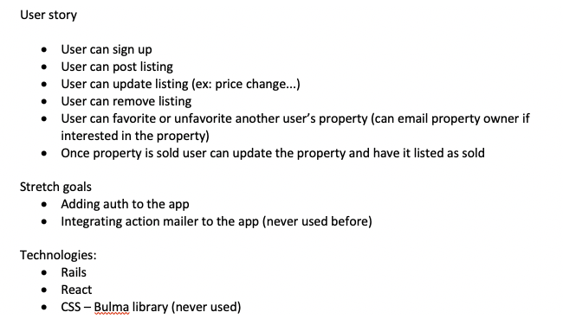
User Story

Slide 3
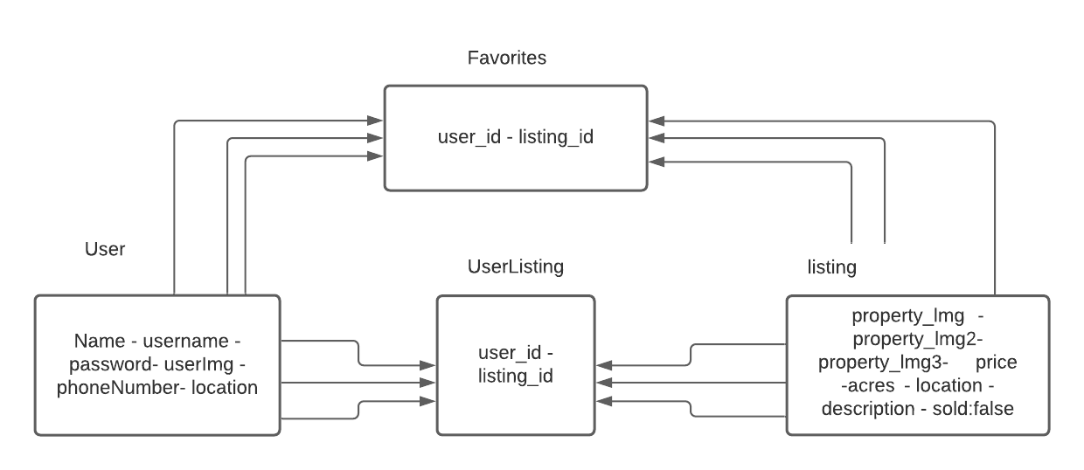
Models

Slide 4
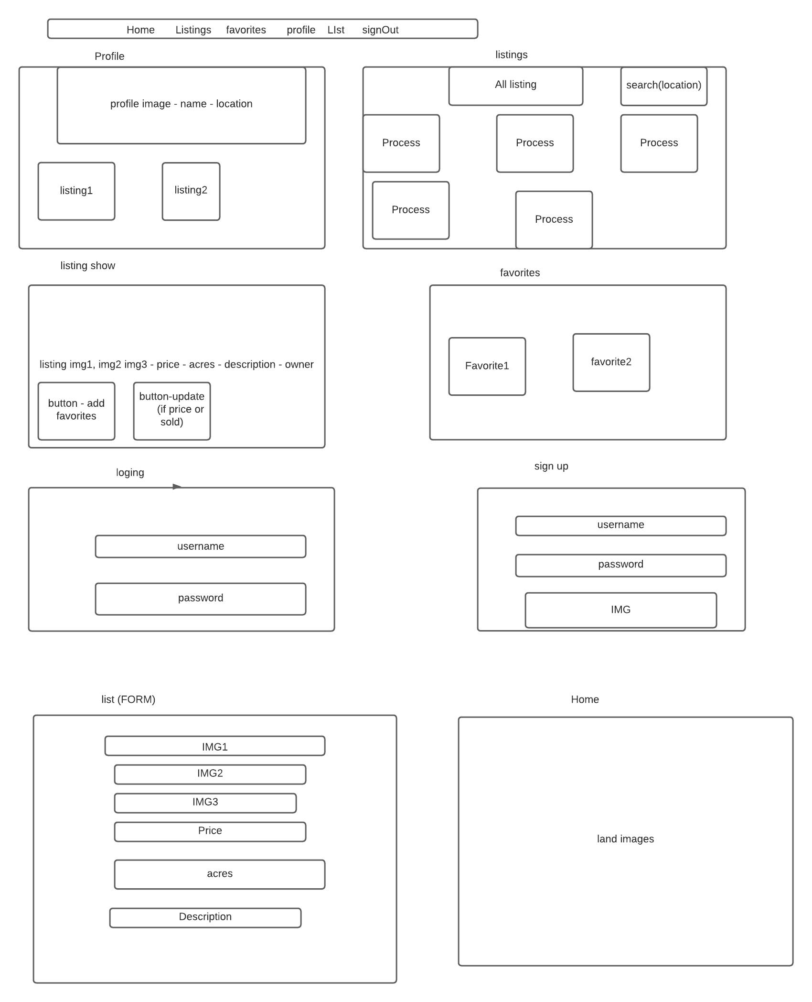
Wireframe

Slide 5
Wireframe

Slide 6
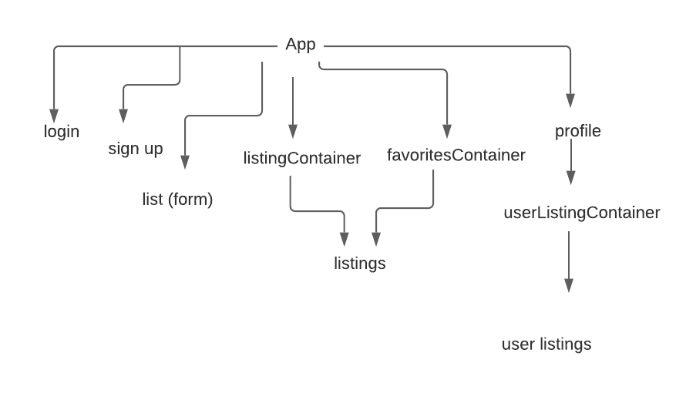
Component Hierarchy

